Slide 1
Naïve Bayesian Classifier
Seminar Presentation
at
IIT Kharagpur
West Bengal-721301
Mohammed Kashif
21MA60R39
M-tech
Computer science and Data processing
1

Slide 2
Today’s discussion
Categorization of Data
What is Data Classification?
Classification Problem
Classification Techniques
Supervised
Unsupervised
Classification Techniques
Naïve Bayesian Classifier
Gaussian Naïve Bayesian Classifier
M-estimate Approach
Accuracy Estimation
2

Slide 3
Categorization of Data:
NOIR Classification
Nominal
Ordinal
Interval
Ratio
Categorical Data
(Qualitative)
Numeric Data
(Quantitative)

Slide 4
Table for Data Categorization
Sr No. | Property | Operation | Type
1 | Distinctiveness | = and != | Categorical
2 | Order | <,<=,>,>=
3 | Addition | (+) and (-) | Numerical
4 | Multiplication | * and \

Slide 5
What is Data Classification?
Data classification is a process of organizing and analyzing different data whether in structured form or unstructured form.
Example:
Teacher classify students as A, B, C, D and F based on their marks. The following is one simple classification rule:
Mark ≥ 𝟗𝟎 :
𝟗𝟎 > Mark ≥ 𝟖𝟎 : 8𝟎 > Mark ≥ 𝟕𝟎 :
𝟕𝟎 > Mark ≥ 𝟔𝟎 : 6𝟎 > Mark :
A
B
C
D
F
3

Slide 6
Examples of Classification of Data.
Life Science: Predicting chronic diseases.
Prediction: Weather, voting, political dynamics, etc.
Entertainment: Categorizing news stories as finance, weather, entertainment, sports, etc.
Social media: Identifying the current trend and future growth
6

Slide 7
Classification Problem
More precisely, a classification problem can be stated as below:
Definition: Classification Problem:
Given a database D ={𝑡₁, 𝑡₂, … . . , 𝑡_{𝑚} } pff tuples and a set of classes C = {𝑐₁, 𝑐₂, … . . , 𝑐_{𝑘}}, the classification problem is to define a mapping f ∶ D → 𝐶, where each 𝑡_{i} is assigned to one class.
Note that tuple 𝑡_{i} ∈ 𝐷 is defined by a set of attributes 𝐴 = {𝐴₁, 𝐴₂, … . . , 𝐴_{𝑛}}.
7

Slide 8
Classification Techniques
Classification consists of assigning a class label to a set of unclassified cases.
Supervised Classification
The set of possible classes is known in advance.
Unsupervised Classification
Set of possible classes is not known. After classification we can try to assign a name to that class.
8

Slide 9
Supervised Classification Technique
Given a collection of records (training set).
Find a model for class attribute as a function of the values of other attributes.
Goal: Previously unseen records should be assigned a class as accurately as possible. Satisfy the property of “mutually exclusive and exhaustive”
9

Slide 10
Classification Techniques
A number of classification techniques are known, which can be broadly classified into the following categories:
Logistic Regression
Support Vector Machine
Decision Tree
Random Forest
Naïve Bayes
K-nearest Neighbor
Artificial Neural Network
10

Slide 11
Baye's Theorem of Probability
11

Slide 12
Joint Probability
Definition: Joint Probability
If P(Rain) and P(Sunny) are the probability of two events, then
𝑃(𝐴 𝖴 𝐵) = 𝑃(𝐴) + 𝑃(𝐵) − 𝑃(𝐴 ∩ 𝐵)
If Rain and Sunny are mutually exclusive, then 𝑃(𝐴 ∩ 𝐵) = 0
If Rain and Sunny are independent events, then 𝑃(𝐴 ∩ 𝐵) = 𝑃(𝐴) . 𝑃(𝐵)
If
Thus, for mutually exclusive events
𝑃(𝐴 𝖴 𝐵) = 𝑃(𝐴) + 𝑃(𝐵)
12

Slide 13
Conditional Probability (useful for Naïve Bayesian)
Generalization of Conditional Probability
The probability that Y occurs given that X is denoted by:
P(Y|X) =
= P(Y^X)/P(X)
= P(X^Y)/P(X)
= P(X|Y) * P(Y)/P(X)
Since,
P(Y|X) = P(Y^X)/P(X).
P(Y|X) = (Number of events in X which are favorable to Y)
/(Number of events in X)
31

Slide 14

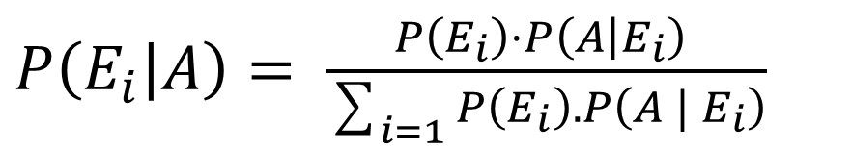
Baye's Theorem
Baye'sTheorem:
Let 𝐸₁, 𝐸₂, … … 𝐸_{𝑛} be n mutually exclusive and exhaustive events associated with a random experiment. If A is any event which occurs with 𝐸₁ 𝑜𝑟 𝐸₂ 𝑜𝑟 … … 𝐸_{𝑛} , then
$P\left(\left.E_{i}\right|A\right)=$ $\frac{P\left(E_{i}\right)⋅P{\left(\left.A\right|E_{i}\right)}_{ }}{\sum_{i=1}{P\left(E_{i}\right).P\left(A{ | E}_{i}\right)}}$
Where $E_{i}$ is ith event.
14

Slide 15
Prior and Posterior Probabilities
P(Rain) and P(Sunny) are called prior probabilities.
P(Rain|Sunny), P(Sunny|Rain) are called posterior probabilities
Suppose, we don't have any information of the event Rain. Then, from the given sample space, we can get,
P(Y=Rain) = 0.5; P(Y=Sunny) = 0.5 (Prior)
Now, P(X = x1/ Y=Rain) = 2/5 =0.4 (Posterior)
X | Y
𝑥₁ | Rain
𝑥₂ | Rain
𝑥₃ | Sunny
𝑥₃ | Rain
𝑥₂ | Sunny
𝑥₁ | Rain
𝑥₁ | Sunny
𝑥₃ | Sunny
𝑥₂ | Sunny
𝑥₂ | Rain
37

Slide 16
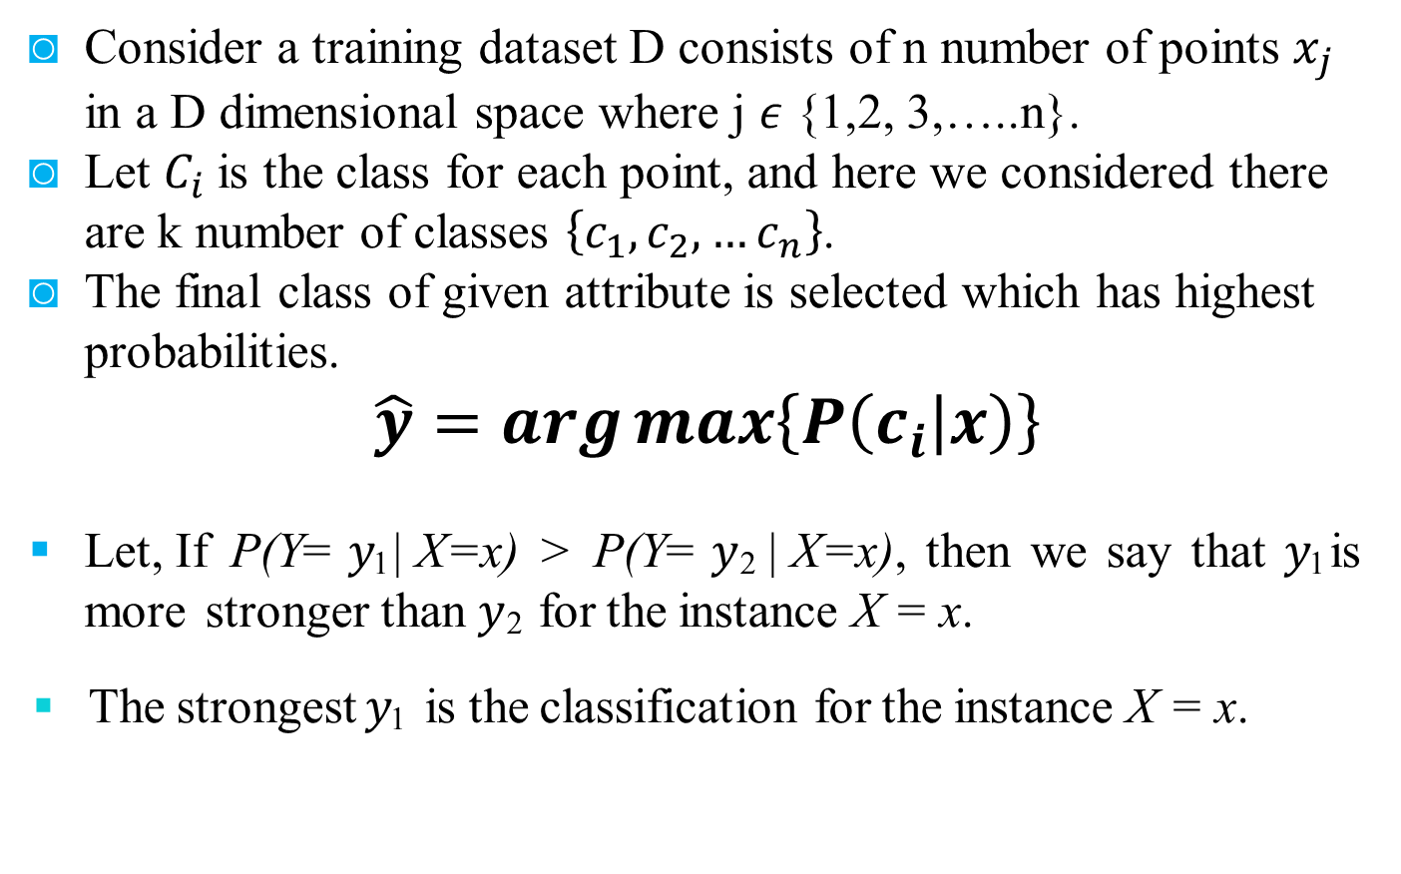
Naïve Bayesian Classifier
Consider a training dataset D consists of n number of points $x_{j}$ in a D dimensional space where j $ε$ {1,2, 3,…..n}.
Let $C_{i}$is the class for each point, and here we considered there are k number of classes $\left\{c_{1},c_{2},…c_{n}\right\}$.
The final class of given attribute is selected which has highest probabilities.
$$\hat{y}=\arg{\max\left\{P\left(\left.c_{i}\right|x\right)\right\}}$$
Let, If P(Y= 𝑦₁ | X=x) > P(Y= 𝑦₂ | X=x), then we say that 𝑦₁ is more stronger than 𝑦₂ for the instance X = x.
The strongest 𝑦₁ is the classification for the instance X = x.

Slide 17
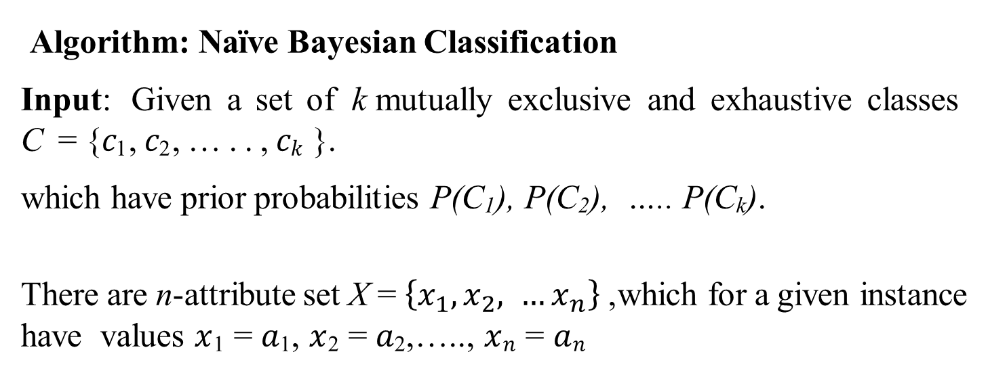
Naïve Bayesian Classifier
Algorithm: Naïve Bayesian Classification
Input: Given a set of k mutually exclusive and exhaustive classes C = {𝑐₁, 𝑐₂, … . . , 𝑐_{𝑘} }.
which have prior probabilities P(C₁), P(C₂), ….. P(C_{k}).
There are n-attribute set X = $\left\{x_{1},x_{2}, …x_{n}\right\}$, which for a given instance have values $x$₁ = 𝑎₁, $x$₂ = 𝑎₂,….., $x$_{𝑛} = 𝑎_{𝑛}

Slide 18

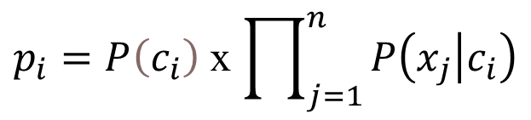
Naïve Bayesian Classifier ( Algorithm continue)
Step: For each 𝑐_{i} ∈ C, calculate the class condition probabilities,
i = 1,2,…..,k
$p_{i}=P\left(c_{i}\right)$ x $\prod_{j=1}^{n}{P\left(\left.x_{j}\right|c_{i}\right)}$
$$p_{x}=\max\left\{p_{1},p_{2}, …p_{k}\right\}$$
Output: 𝐶_{𝑥} is the classification
Note: ∑ 𝒑_{𝒊} ≠ 𝟏, because they are not probabilities rather proportion values (to posterior probabilities)

Slide 19
Naïve Bayesian Classifier
Pros and Cons
The Naïve Baye's approach is a very popular one, which often works well.
However, it has a number of potential problems:
It relies on all attributes being categorical.
If the data is less, then it estimates poorly.

Slide 20
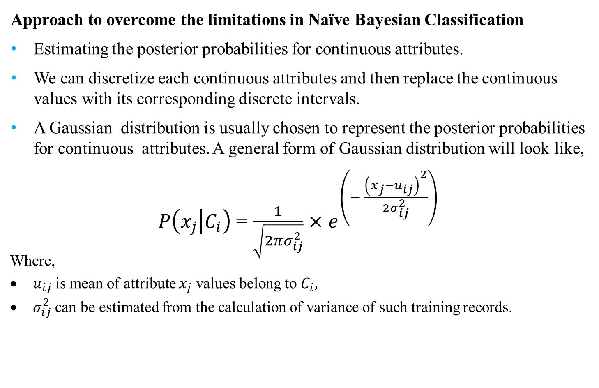
Naïve Bayesian Classifier
Approach to overcome the limitations in Naïve Bayesian Classification
Estimating the posterior probabilities for continuous attributes.
We can discretize each continuous attributes and then replace the continuous values with its corresponding discrete intervals.
A Gaussian distribution is usually chosen to represent the posterior probabilities for continuous attributes. A general form of Gaussian distribution will look like,
$P\left(\left.x_{j}\right|C_{i}\right)$ = $\frac{1}{\sqrt{2πσ_{ⅈj}^{2}}}$ $×$ $ⅇ^{\left(− \frac{{\left(x_{j}−u_{ij}\right)}^{2}}{2σ_{ⅈj}^{2}}\right)}$
Where,
$u_{ij}$is mean of attribute $x_{j}$ values belong to $C_{i},$
$σ_{ⅈj}^{2}$ can be estimated from the calculation of variance of such training records.

Slide 21
Gaussian Naïve Bayesian Classifier
M-estimate of Conditional Probability
The M-estimation is to deal with the potential problem of Naïve Bayesian Classifier when training data size is too poor.
If the posterior probability for one of the attribute is zero, then the overall class- conditional probability for the class vanishes.
In other words, if training data do not cover many of the attribute values, then we may not be able to classify some of the test records.
This problem can be addressed by using the M-estimate approach.

Slide 22
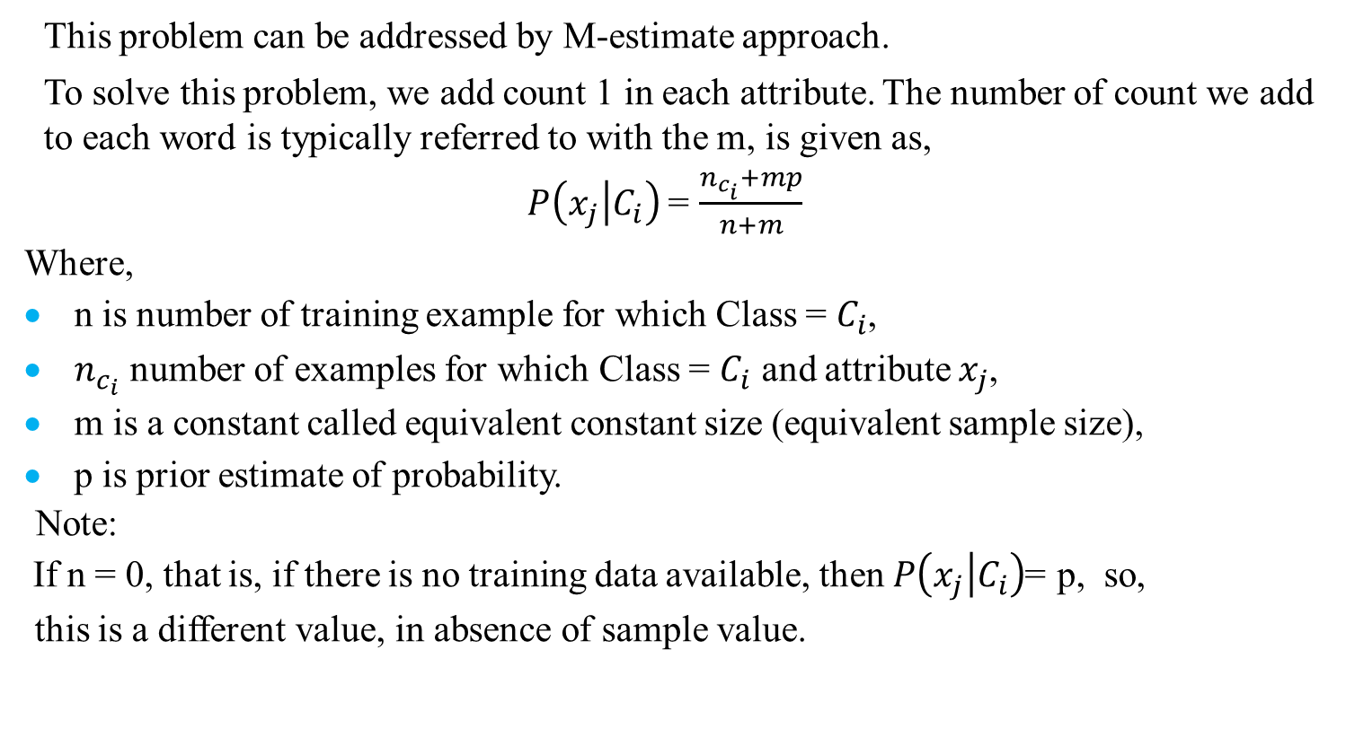
M-estimate Approach
This problem can be addressed by M-estimate approach.
To solve this problem, we add count 1 in each attribute. The number of count we add to each word is typically referred to with the m, is given as,
$P\left(\left.x_{j}\right|C_{i}\right)$ = $\frac{n_{c_{i}}+mp}{n+m}$
Where,
n is number of training example for which Class = $C_{i}$,
$n_{c_{i}}$ number of examples for which Class = $C_{i}$ and attribute $x_{j}$,
m is a constant called equivalent constant size (equivalent sample size),
p is prior estimate of probability.
Note:
If n = 0, that is, if there is no training data available, then $P\left(\left.x_{j}\right|C_{i}\right)$ =p, so, this is a different value, in absence of sample value.

Slide 23
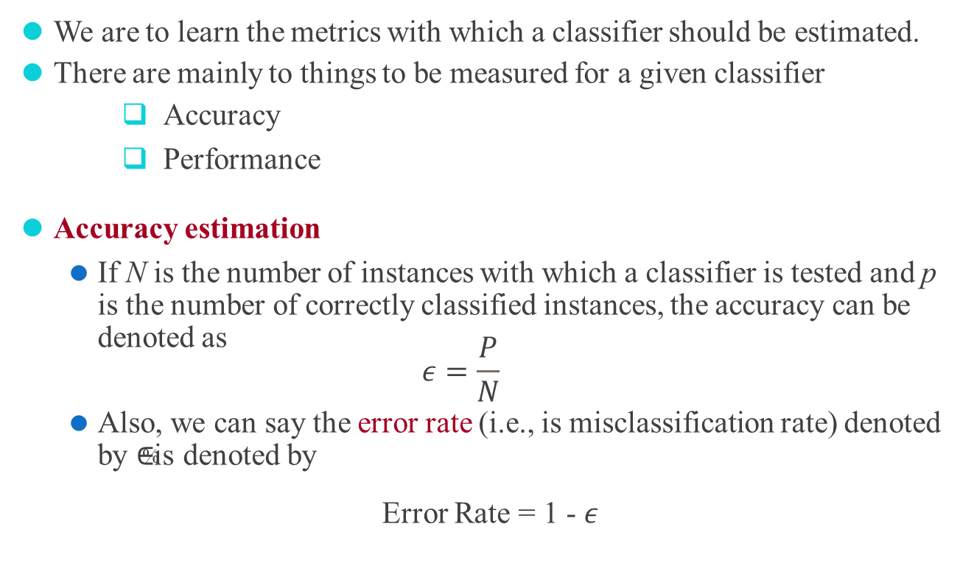
Accuracy Estimation:
We are to learn the metrics with which a classifier should be estimated.
There are mainly to things to be measured for a given classifier
Accuracy
Performance
Accuracy estimation
If N is the number of instances with which a classifier is tested and p is the number of correctly classified instances, the accuracy can be denoted as
$$ε=\frac{P}{N}$$
Also, we can say the error rate (i.e., is misclassification rate) denoted by ∈% is denoted by
Error Rate = 1 - $ε$

Slide 24
Confusion Matrix
There are four quadrants in the confusion matrix, which are symbolized as below,
True Positive (TP: f++) : The number of instances that were positive (+) and correctly classified as positive (+v).
False Negative (FN: f+-): The number of instances that were positive (+) and incorrectly classified as negative (-). It is also known as Type 2 Error.
False Positive (FP: f-+): The number of instances that were negative (-) and incorrectly classified as (+). This also known as Type 1 Error.
True Negative (TN: f--): The number of instances that were negative (-) and correctly classified as (-).

Slide 25
Example:
 | WEATHER | TEMPERATURE | HUMIDITY | WINDY | PLAY GOLF
1 | Rainy | Hot | High | False | No
2 | Rainy | Hot | High | True | No
3 | Overcast | Hot | High | False | Yes
4 | Sunny | Mild | High | False | Yes
5 | Sunny | Cool | Normal | False | Yes
6 | Sunny | Cool | Normal | True | No
7 | Overcast | Cool | Normal | True | Yes
8 | Rainy | Mild | High | False | No
9 | Rainy | Cool | Normal | False | Yes
10 | Sunny | Mild | Normal | False | Yes
11 | Rainy | Mild | Normal | True | Yes
12 | Overcast | Mild | High | True | Yes
13 | Overcast | Hot | Normal | False | Yes
14 | Sunny | Mild | High | True | No

Slide 26
Reference
Data Mining and Analysis: Fundamental Concepts and Algorithms: Mohammed J. Zaki Wagner Meira Jr.
Comparing different supervised machine learning algorithms for disease prediction: (BMC Medical Informatics and Decision Making).
https://highdemandskills.com
Probability & Statistics for Engineers & Scientists: (Ronald E. Walpole )
Classification of 20 News Group with Naïve Bayes Classifier: Abdulwahab
An Implementation of Naive Bayes Classifier: Feng-Jen Yang
The Impact of Data Preprocessing on the Performance of a Naive Bayes Classifier:
Priyanga Chandrasekar;Kai Qian

Slide 27
Thank You

